Slide 1


Social Buzz

Slide 2


Today's agenda
Project recap
Problem
The Analytics team
Process
Insights
Summary

Slide 3

Social Buzz
Project Recap
To start our engagement with Social Buzz, we are running a 3-month initial project in order to prove to them that we are the best firm to work with. They are expecting the following:
- An audit of their big data practice
- Recommendations for a successful IPO
- An analysis of their content categories that highlight the top 5 categories with the largest aggregate popularity

Slide 4


Problem
Over 100000 posts per day!
But how to capitalize on that?
An analysis of their content categories that highlight the top 5 categories with the largest aggregate popularity

Slide 5



Andrew Fleming
Chief Technical Architect
The Analytics team
Marcus rompton
Senior Principle
Shreyash Jaiswal
Data Analyst

Slide 6
Process
1
Data Understanding
2
Data Cleaning
3
Data Modelling
4
Data Analysis
5
Uncover Insights

Slide 7

Insights
16
1897
May’2021
Reaction to the most popular category “Animal”
The month with the most posts
Unique categories

Slide 8
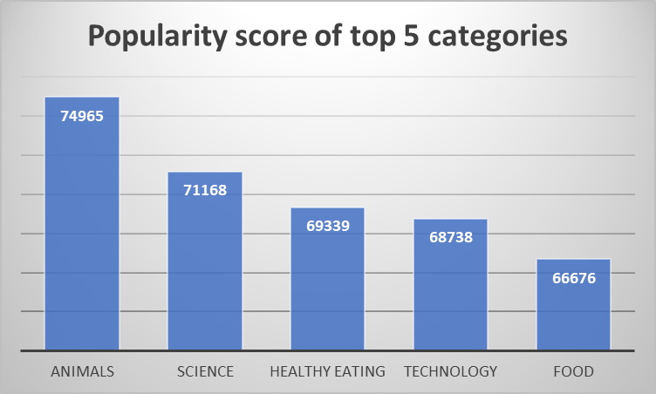

Slide 9
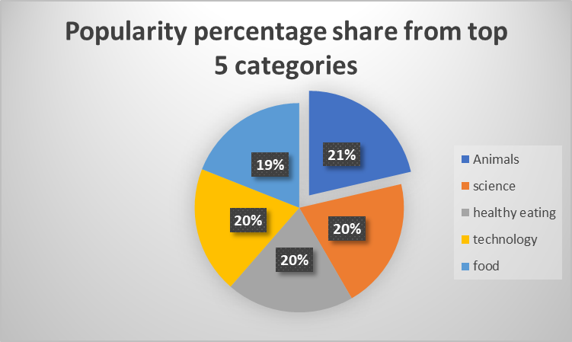

Slide 10

Analysis
Animals and science are the two most popular categories of content, showing that people enjoy "real-life" and "factual" content the most.
Healthy eating and food Categories make it into the top 5 categories showing people care a lot about what they are eating and how their health are getting affected by them.
Summary
Insights
There are 16 Unique categories,
May’21 is the month with the most posts and
1897 reaction to the most popular category ‘animal’

Slide 11

Thank you!
ANY QUESTIONS?

